Slide 1



VLANs: motivation
consider:
CS user moves office to EE, but wants connect to CS switch?
single broadcast domain:
all layer-2 broadcast traffic (ARP, DHCP, unknown location of destination MAC address) must cross entire LAN
security/privacy, efficiency issues
Computer
Science
Computer
Engineering
Electrical
Engineering

Slide 2

VLANs
port-based VLAN: switch ports grouped (by switch management software) so that single physical switch ……
Virtual Local
Area Network
1
7
9
15
2
8
10
16
switch(es) supporting VLAN capabilities can be configured to define multiple virtual LANS over single physical LAN infrastructure.
…
…
Electrical Engineering
(VLAN ports 1-8)
Computer Science
(VLAN ports 9-15)
… operates as multiple virtual switches
1
7
9
15
2
8
10
16
…
…
Electrical Engineering
(VLAN ports 1-8)
Computer Science
(VLAN ports 9-16)

Slide 3

Port-based VLAN
router
traffic isolation: frames to/from ports 1-8 can only reach ports 1-8
can also define VLAN based on MAC addresses of endpoints, rather than switch port
1
7
9
15
2
8
10
16
dynamic membership: ports can be dynamically assigned among VLANs
…
…
Electrical Engineering
(VLAN ports 1-8)
Computer Science
(VLAN ports 9-15)
forwarding between VLANS: done via routing (just as with separate switches)
in practice vendors sell combined switches plus routers

Slide 4
VLANS spanning multiple switches
1
7
9
15
1
3
5
7
2
8
10
16
2
4
6
8
…
…
Electrical Engineering
(VLAN ports 1-8)
Computer Science
(VLAN ports 9-15)
Ports 2,3,5 belong to EE VLAN
Ports 4,6,7,8 belong to CS VLAN
trunk port: carries frames between VLANS defined over multiple physical switches
frames forwarded within VLAN between switches can’t be vanilla 802.1 frames (must carry VLAN ID info)
802.1q protocol adds/removed additional header fields for frames forwarded between trunk ports

Slide 5
802.1Q VLAN frame format
type
preamble
dest.
address
source
address
data (payload)
CRC
802.1 frame
type
preamble
dest.
address
source
address
data (payload)
CRC
802.1Q frame
2-byte Tag Protocol Identifier
(value: 81-00)
Recomputed
CRC
Tag Control Information (12 bit VLAN ID field,
3 bit priority field like IP TOS)

Slide 6
15-3 VIRTUAL LANs
We can roughly define a virtual local area network (VLAN) as a local area network configured by software, not by physical wiring.

Slide 7
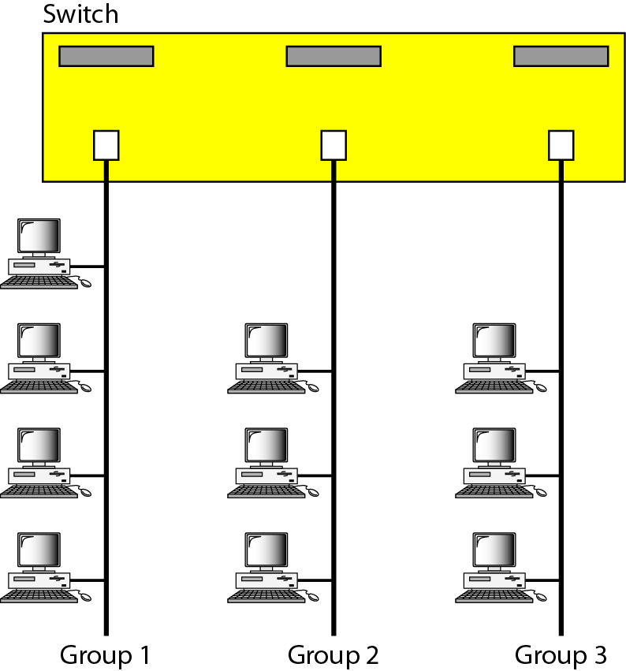
Figure 15.15 A switch connecting three LANs

Slide 8
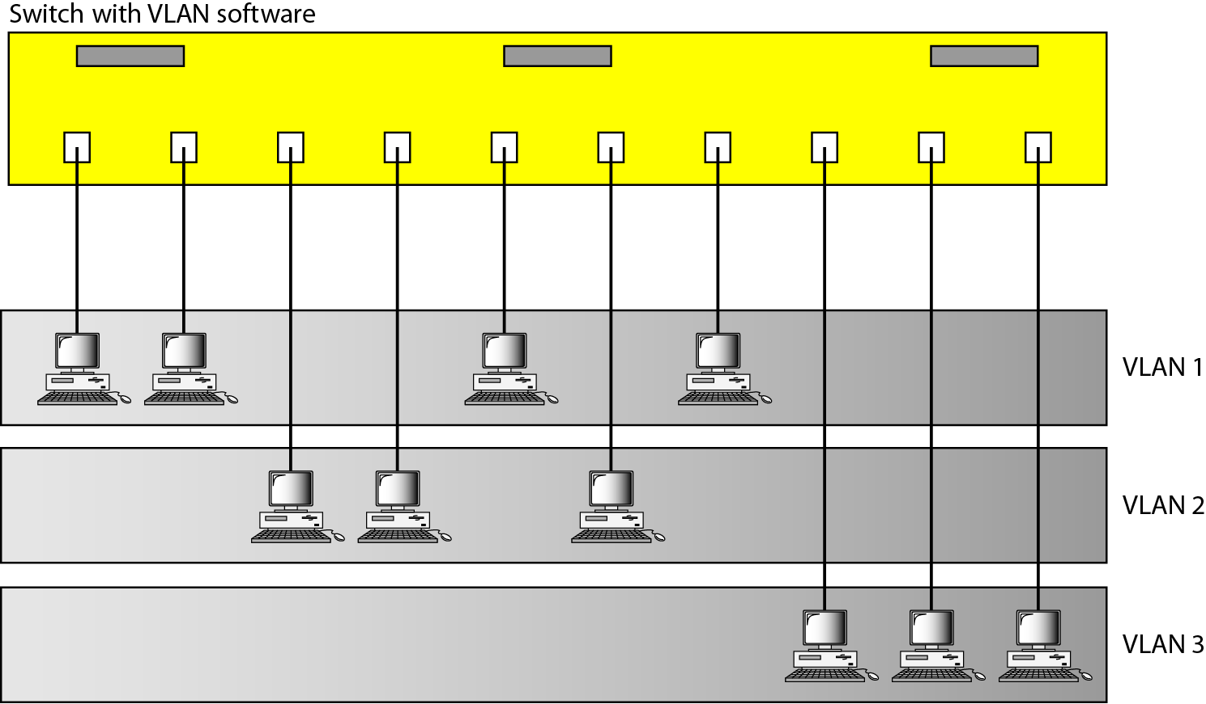
Figure 15.16 A switch using VLAN software

Slide 9
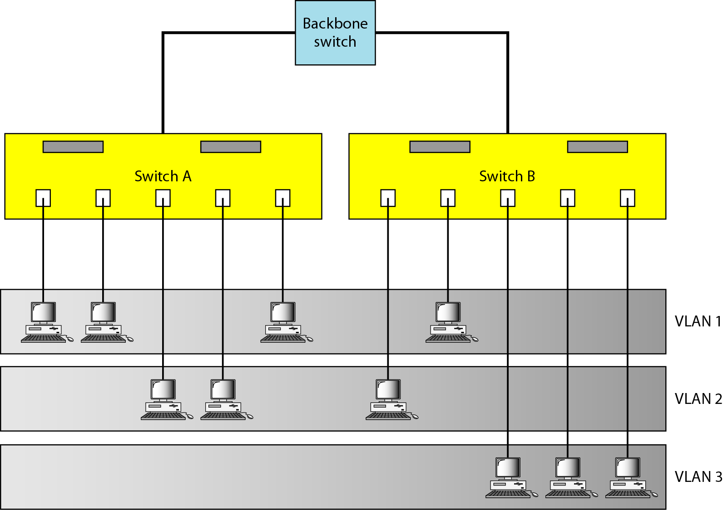
Figure 15.17 Two switches in a backbone using VLAN software

Slide 10

Note
VLANs create broadcast domains.

